Slide 1

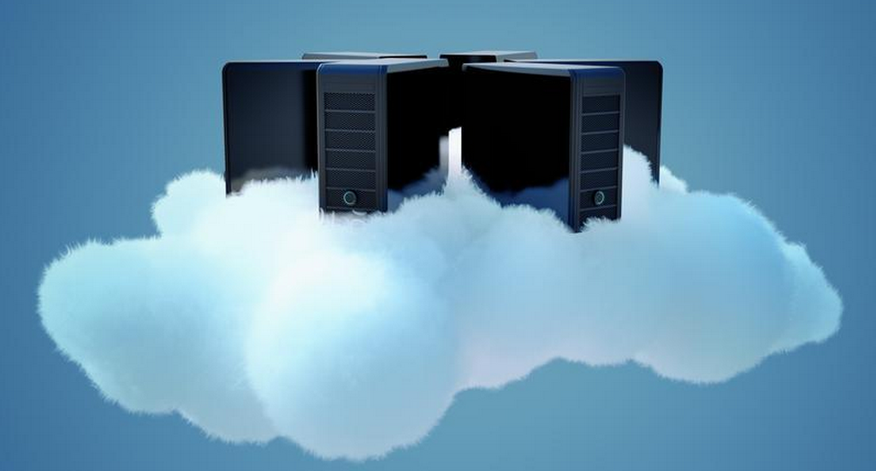

AWS Training - Session 4
Dr. Prabhakar PhD
Senior Integration Engineer
Decision Minds, Bengaluru.

Slide 2
Contents
Elastic Compute Cloud Part II

Slide 3
Connecting to an Amazon EC2 instance
There are several ways to connect to an EC2 instance once it’s launched.
Remote Desktop Connection is the standard way to connect to Windows instances.
An SSH client (standalone or web-based) is used to connect to Linux instances.

Slide 4
Connecting to Linux/UNIX Instances from Linux/UNIX with SSH
Prerequisites:
Most Linux/UNIX computers include an SSH client by default, if not it can be downloaded from openssh.org
Enable SSH traffic on the instance (using security groups)
Get the path the private key used when launching the instance
In a command line shell, change directory to the path of the private key file
Use the chmod command to make sure the private key file isn’t publicly viewable
A key pair consists of a public key that AWS stores and a private key file that you store (downloaded as PEM file).
PEM stands for Privacy Enhanced Mail and is a widely used X.509 encoding format used for security certificates.

Slide 5
Transferring files to Linux/UNIX instances from Linux/UNIX with SCP
Prerequisites:
Enable SSH traffic on the instance
Install an SCP client (included by default mostly)
Get the ID of the Amazon EC2 instance, public DNS of the instance, and the path to the private key
If the key file is My_Keypair.pem, the file to transfer is samplefile.txt, and the instance’s DNS name is ec2-184-72-204-112.compute-1.amazonaws.com, the command below copies the file to the ec2-user home

Slide 6
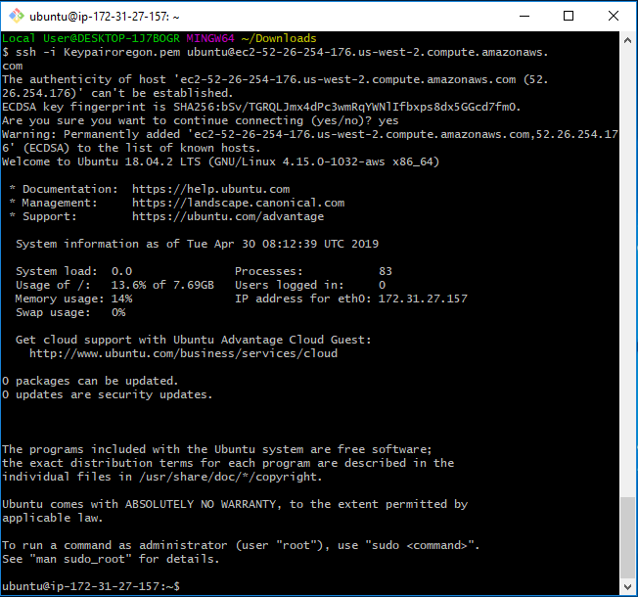
Elastic Compute Cloud

Slide 7
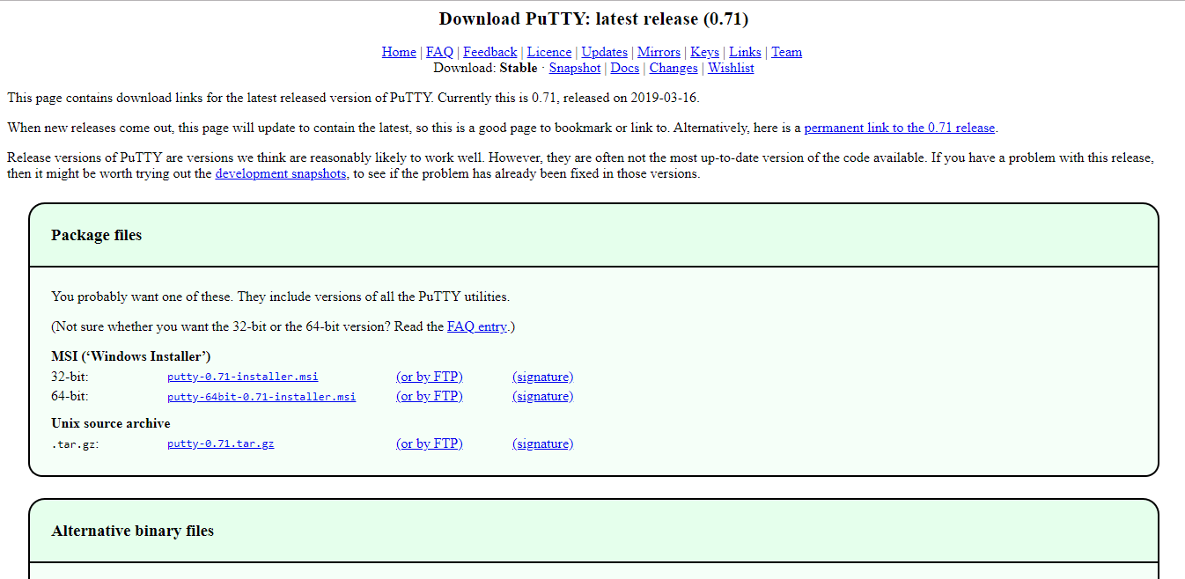
Connecting to Linux/UNIX Instances from Windows using Putty
PuTTY does not natively support the PEM format that AWS uses, so you need to first convert your PEM file to a PPK file (PPK = PuTTY Private Key). To do this, you use the PuTTYgen utility.

Slide 8
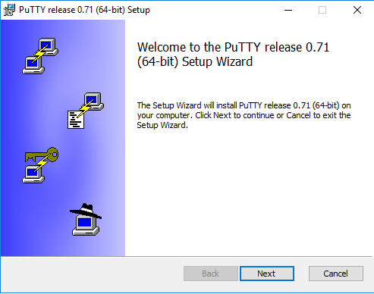
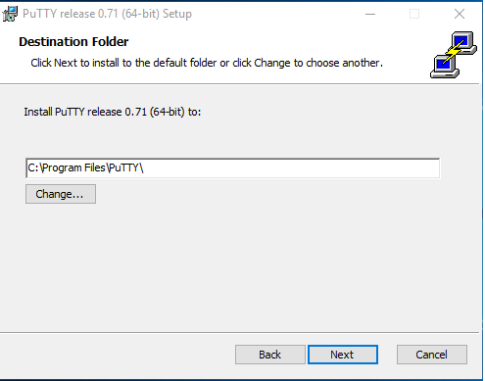
Connecting to Linux/UNIX Instances from Windows using Putty

Slide 9
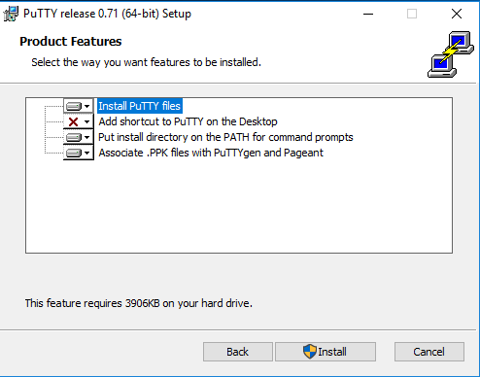
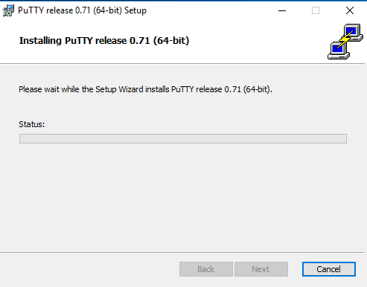
Connecting to Linux/UNIX Instances from Windows using Putty

Slide 10
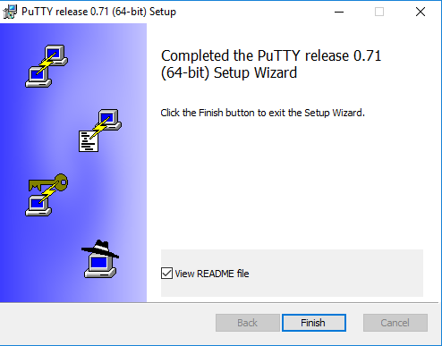
Connecting to Linux/UNIX Instances from Windows using Putty

Slide 11
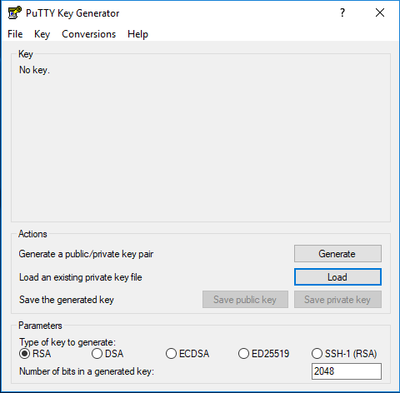
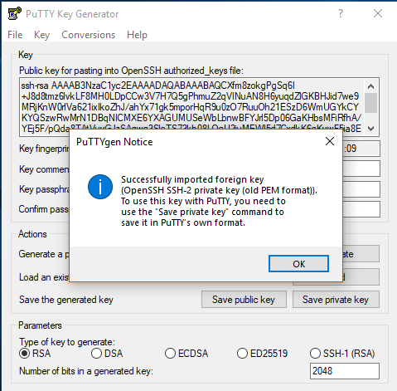
Generating Putty Private Key

Slide 12
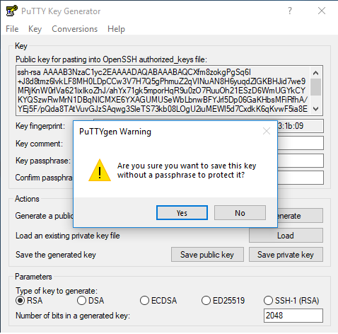
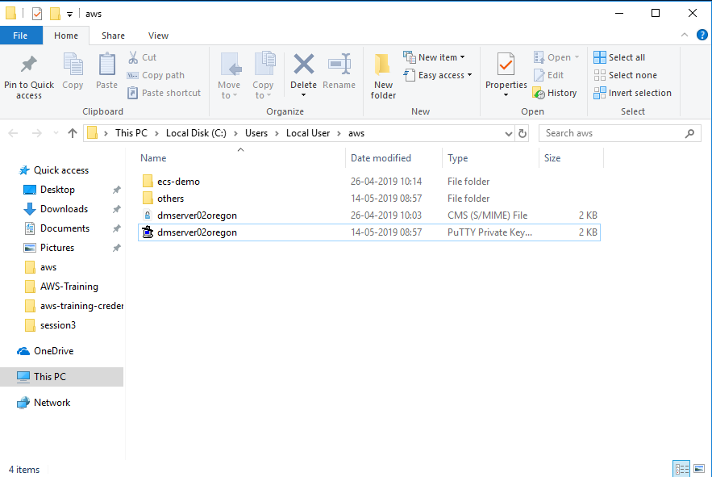
Generating Putty Private Key

Slide 13
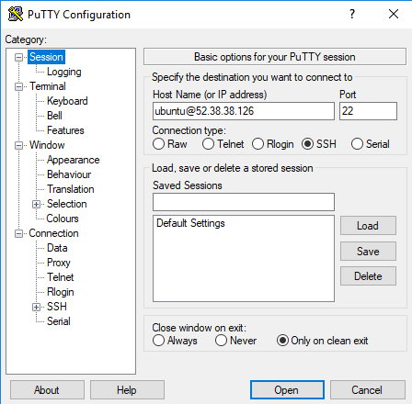
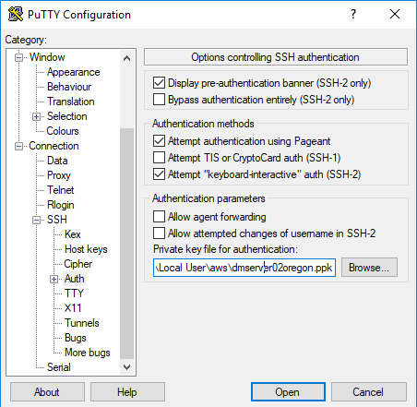
Connecting to Linux/UNIX Instances from Windows using Putty

Slide 14
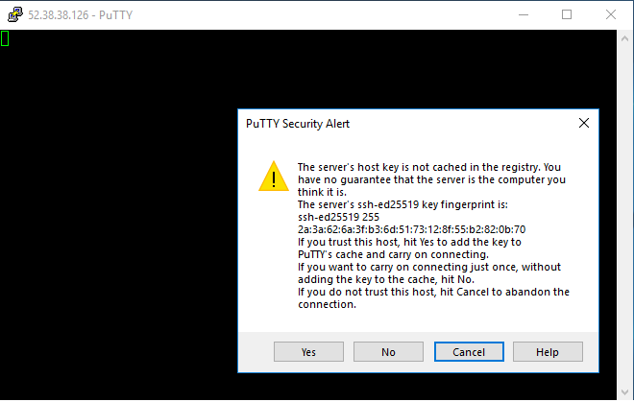
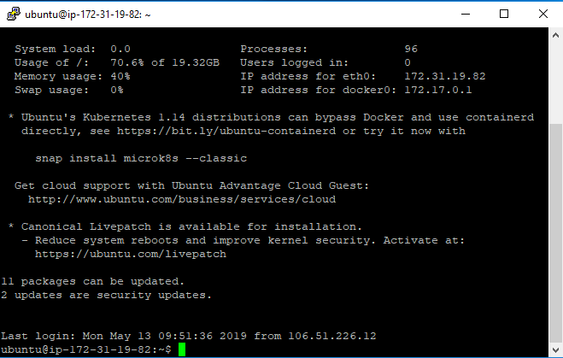
Connecting to Linux/UNIX Instances from Windows using Putty

Slide 15
Elastic Compute Cloud
Difference between Linux and Windows instance Pricing

Slide 16
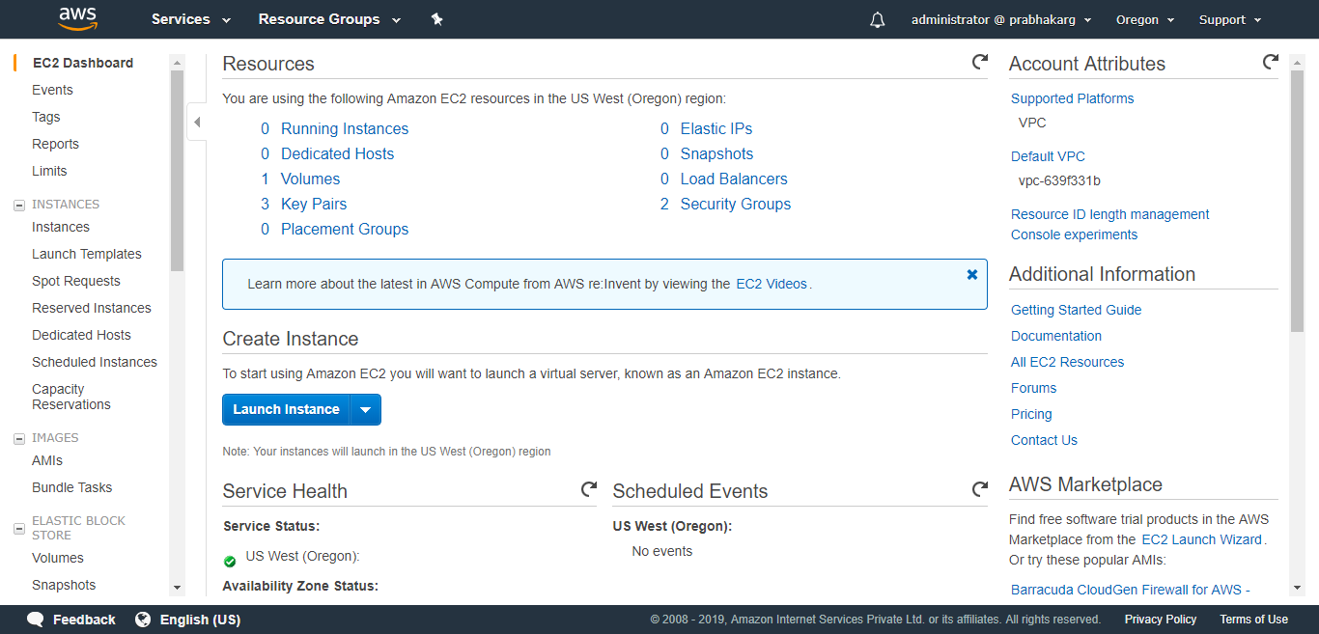
Elastic Compute Cloud
Demonstration: Windows Instance

Slide 17
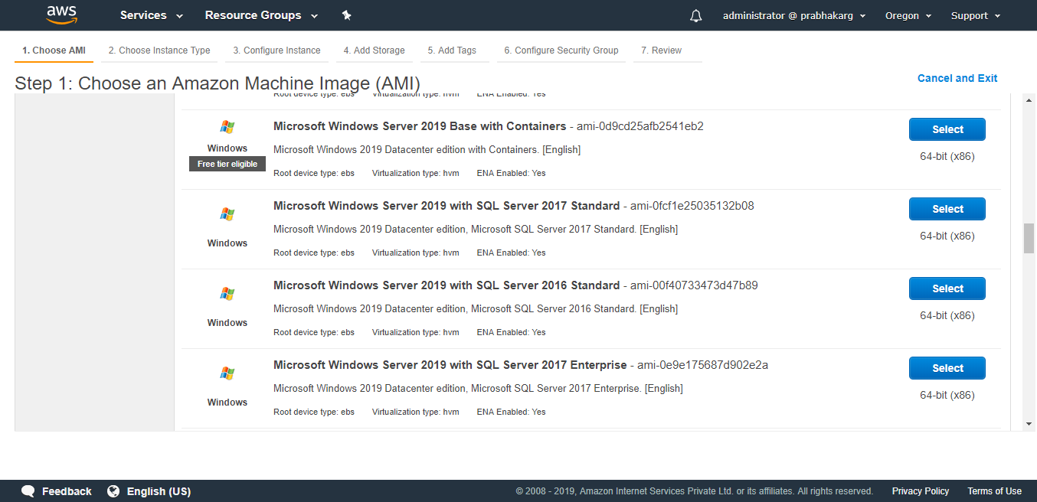
Elastic Compute Cloud

Slide 18
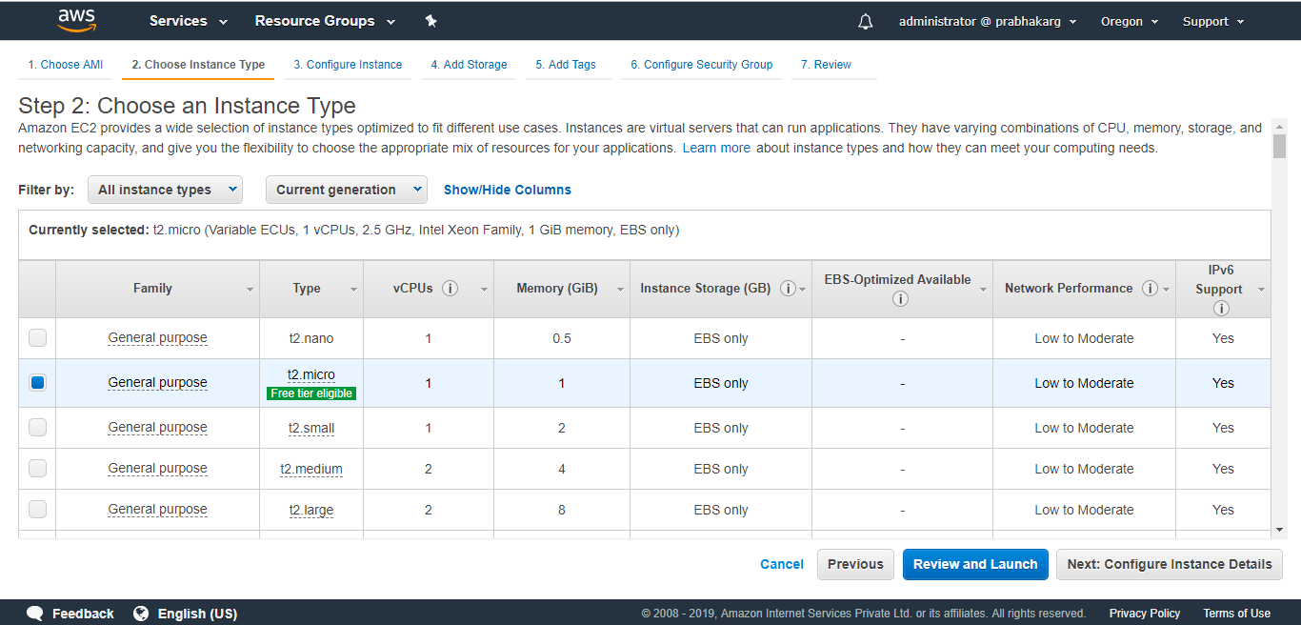
Elastic Compute Cloud

Slide 19
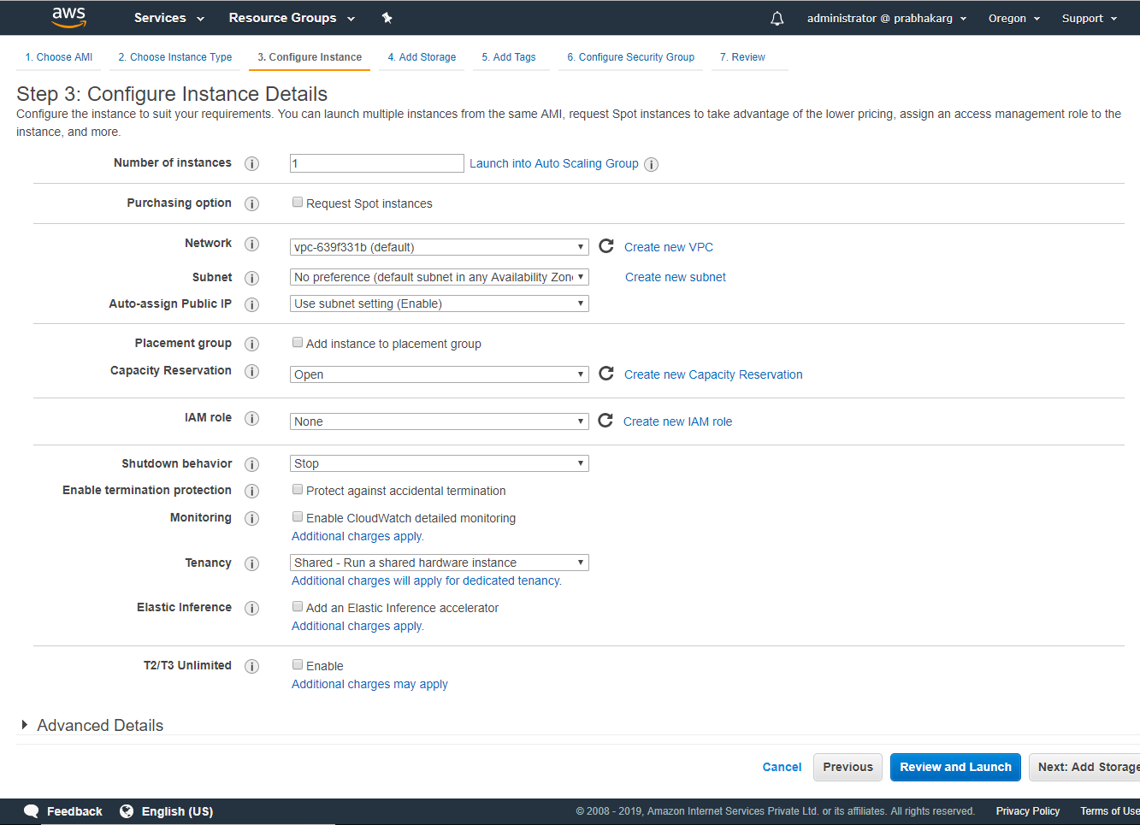

Slide 20
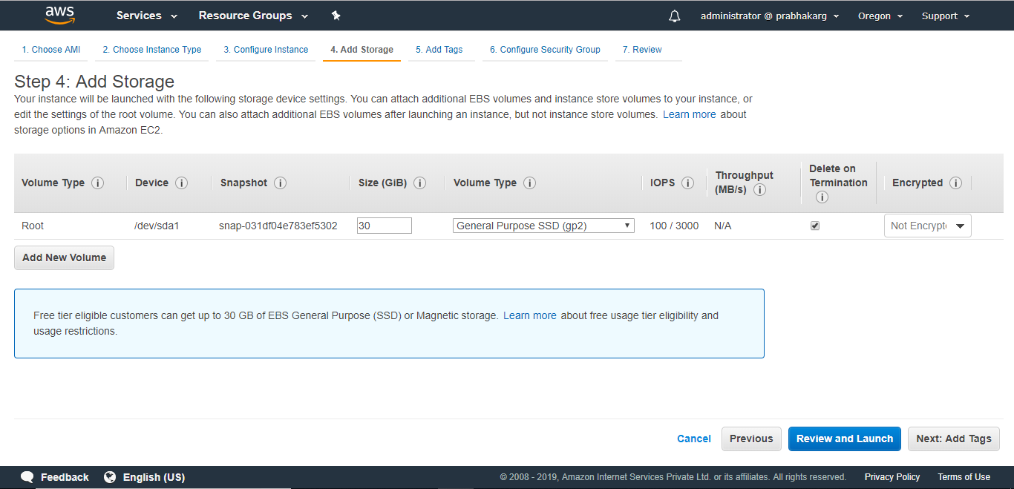
Elastic Compute Cloud

Slide 21
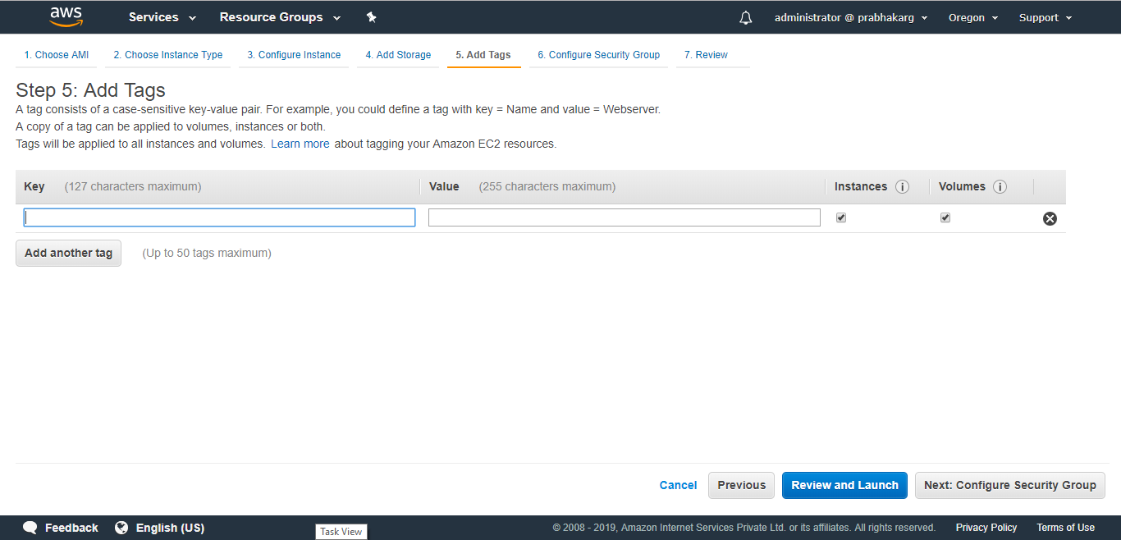
Elastic Compute Cloud

Slide 22
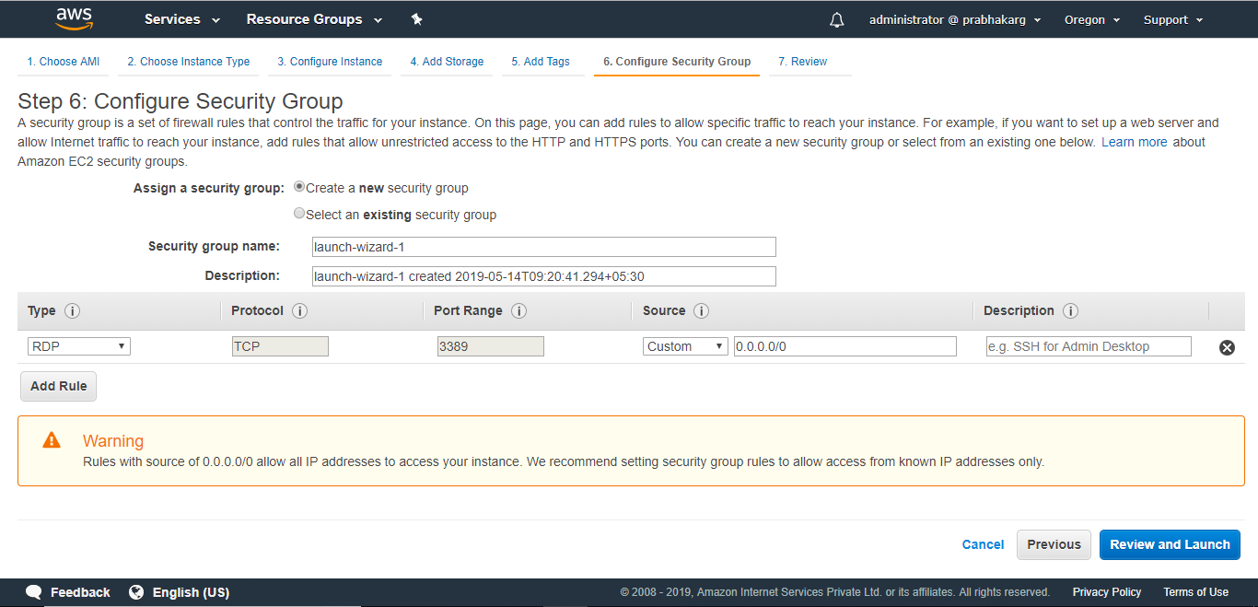
Elastic Compute Cloud

Slide 23
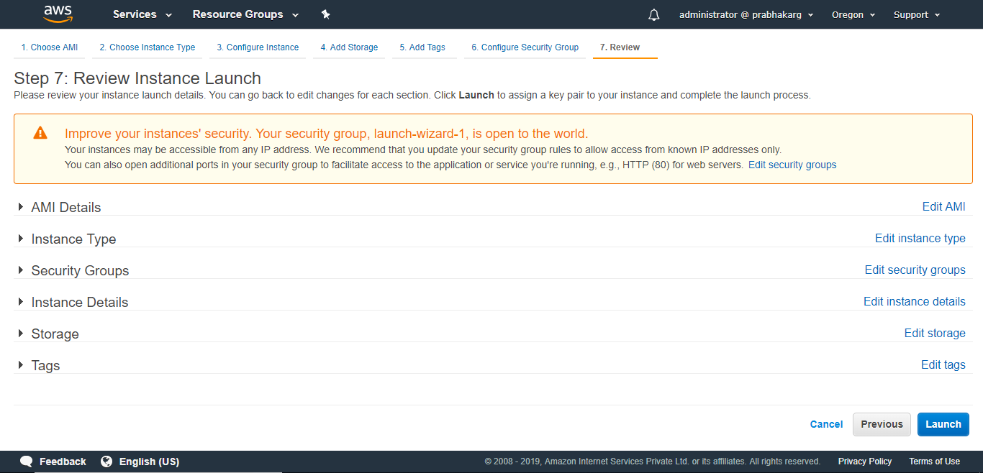
Elastic Compute Cloud

Slide 24
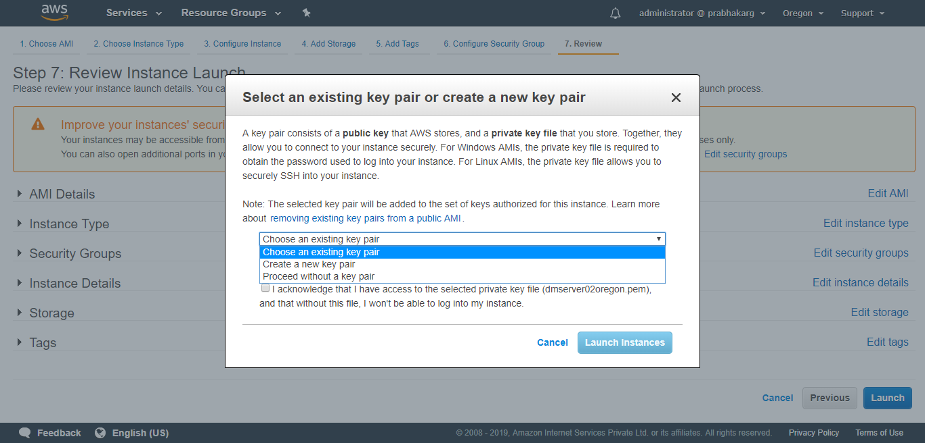
Elastic Compute Cloud

Slide 25
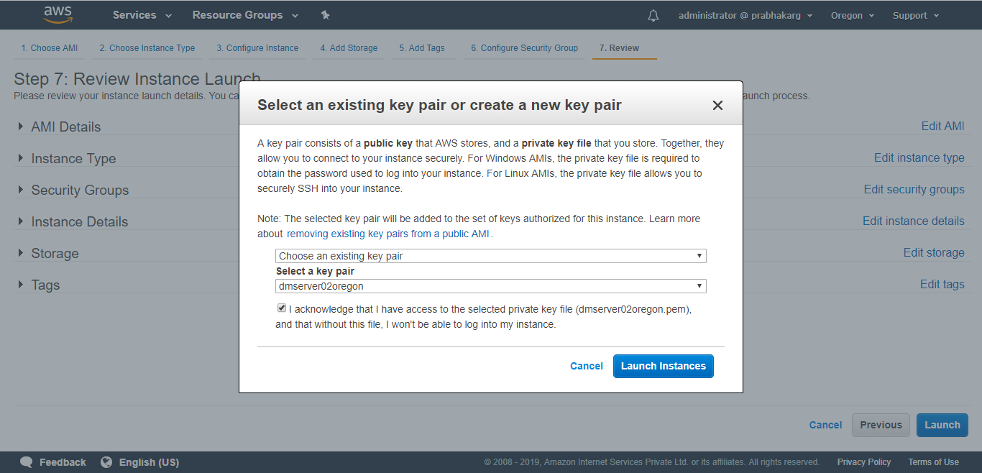
Elastic Compute Cloud

Slide 26
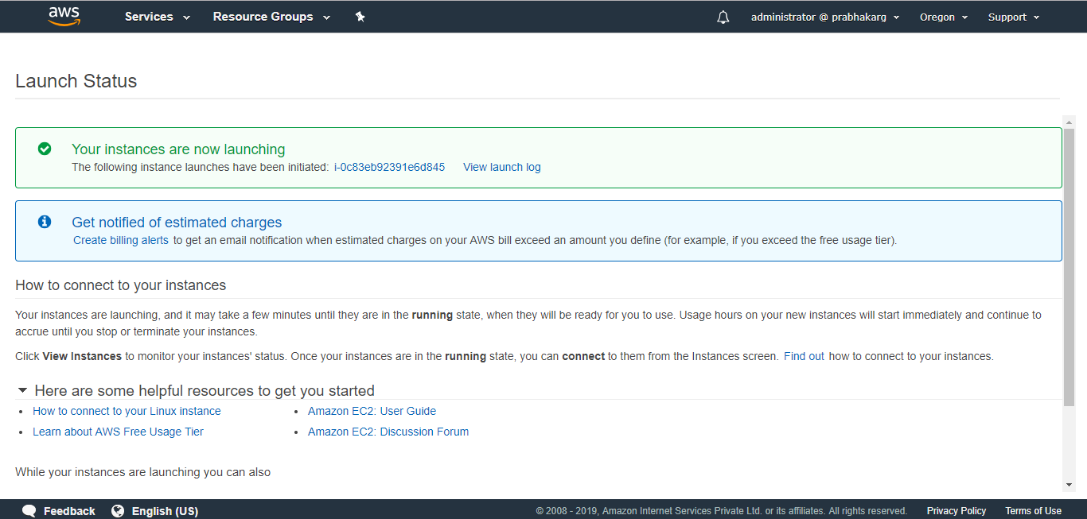
Elastic Compute Cloud

Slide 27
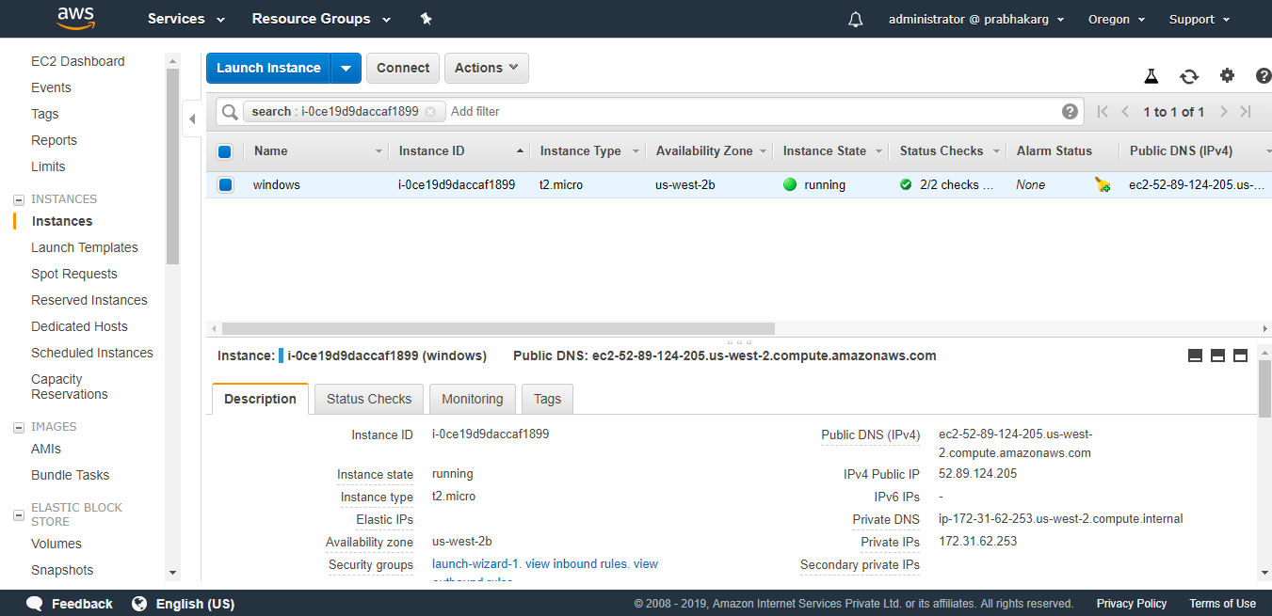
Elastic Compute Cloud

Slide 28
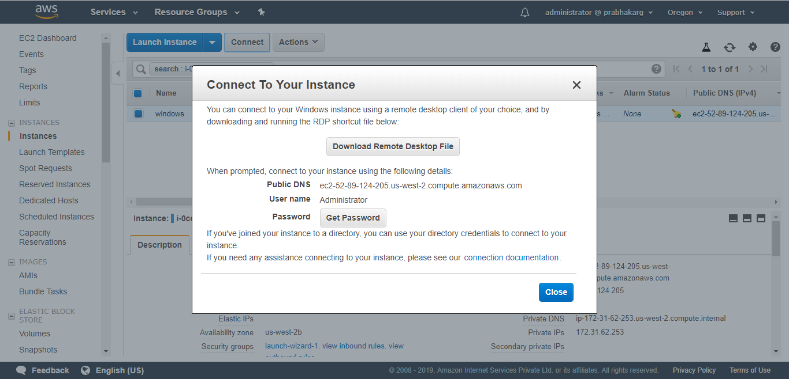
Connecting to Window Instances from Windows using Remote Desktop

Slide 29
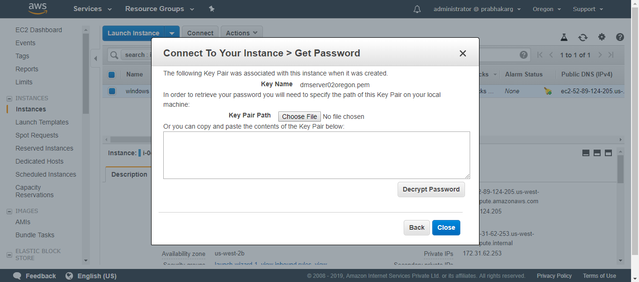
Connecting to Window Instances from Windows using Remote Desktop

Slide 30
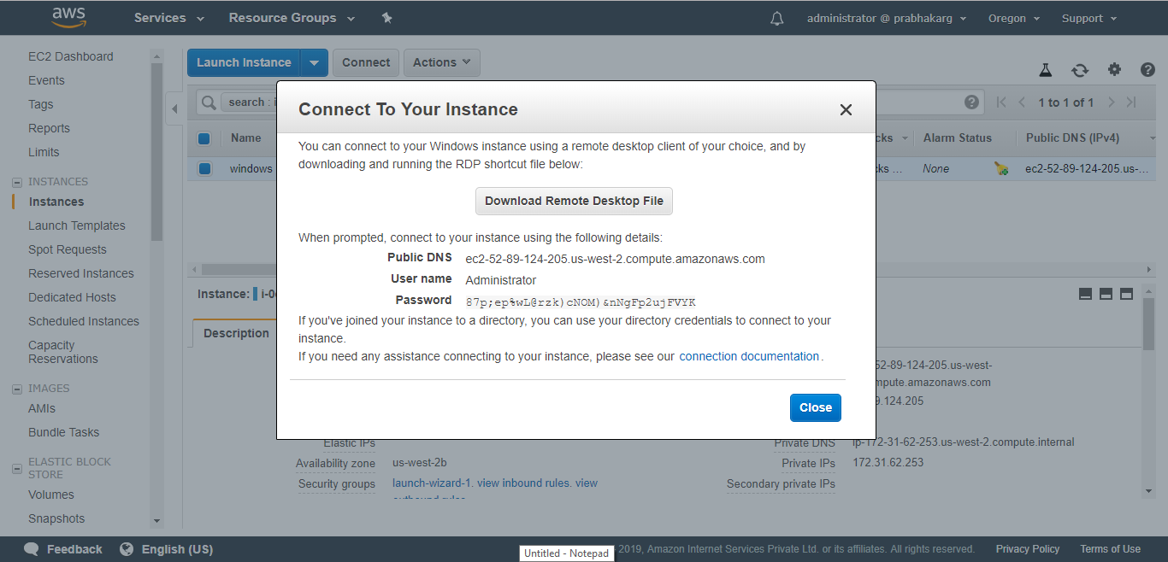
Connecting to Window Instances from Windows using Remote Desktop

Slide 31
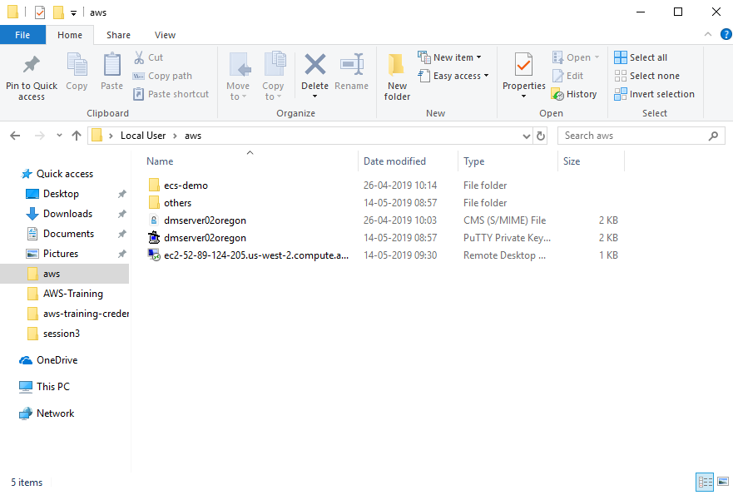
Connecting to Window Instances from Windows using Remote Desktop

Slide 32
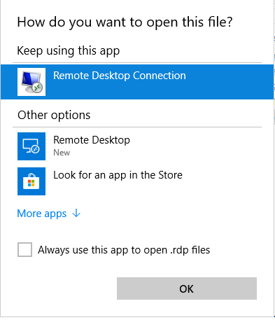
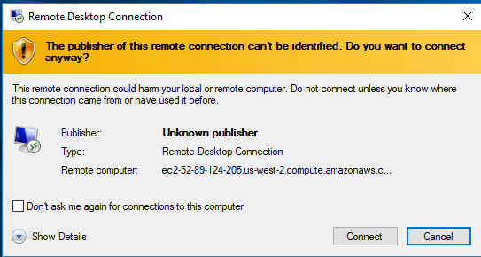
Connecting to Window Instances from Windows using Remote Desktop

Slide 33
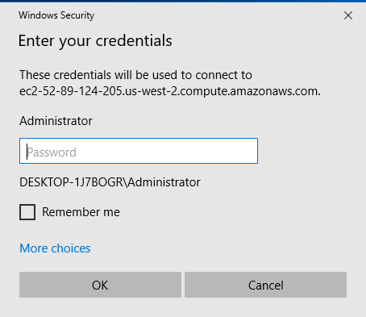
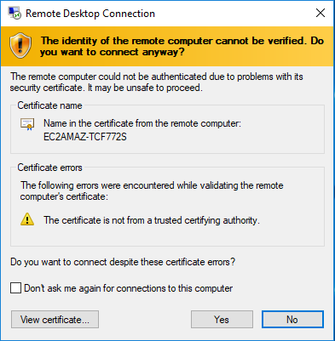
Connecting to Window Instances from Windows using Remote Desktop

Slide 34
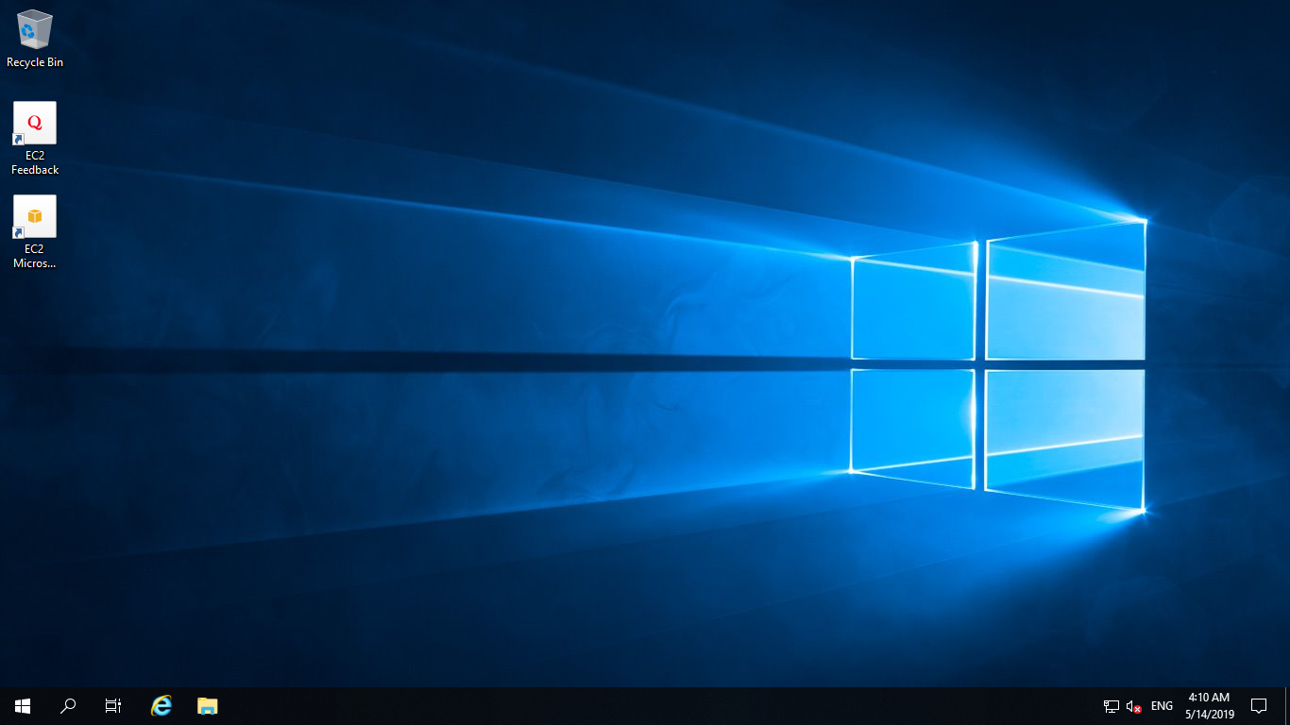
Connecting to Window Instances from Windows using Remote Desktop

Slide 35
Terminating Instances
If the instance launched is not in the free usage tier, as soon as the instance starts to boot, the user is billed for each hour the instance keeps running.
A terminated instance cannot be restarted.
To terminate an instance:
Open the Amazon EC2 console
In the navigation pane, click Instances
Right-click the instance, then click Terminate
Click Yes, Terminate when prompted for confirmation

Slide 36
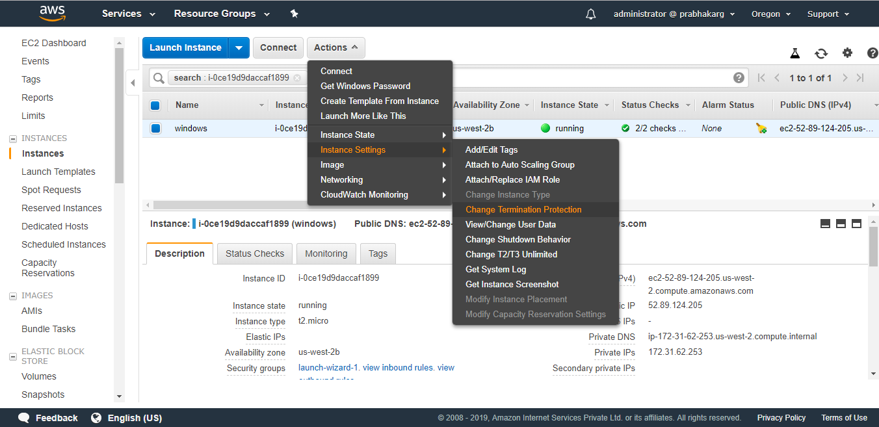
Terminating Instances

Slide 37
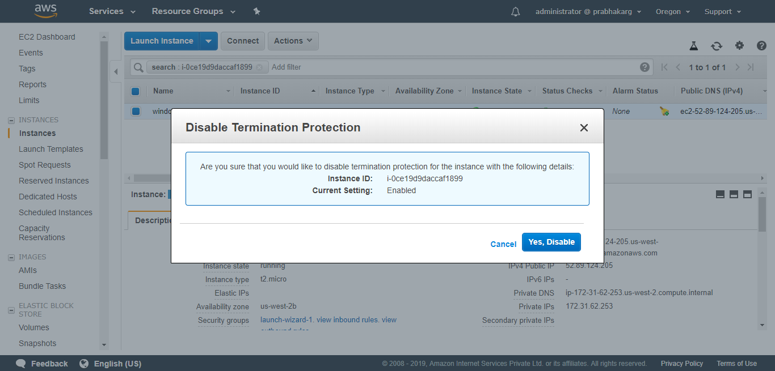
Terminating Instances

Slide 38
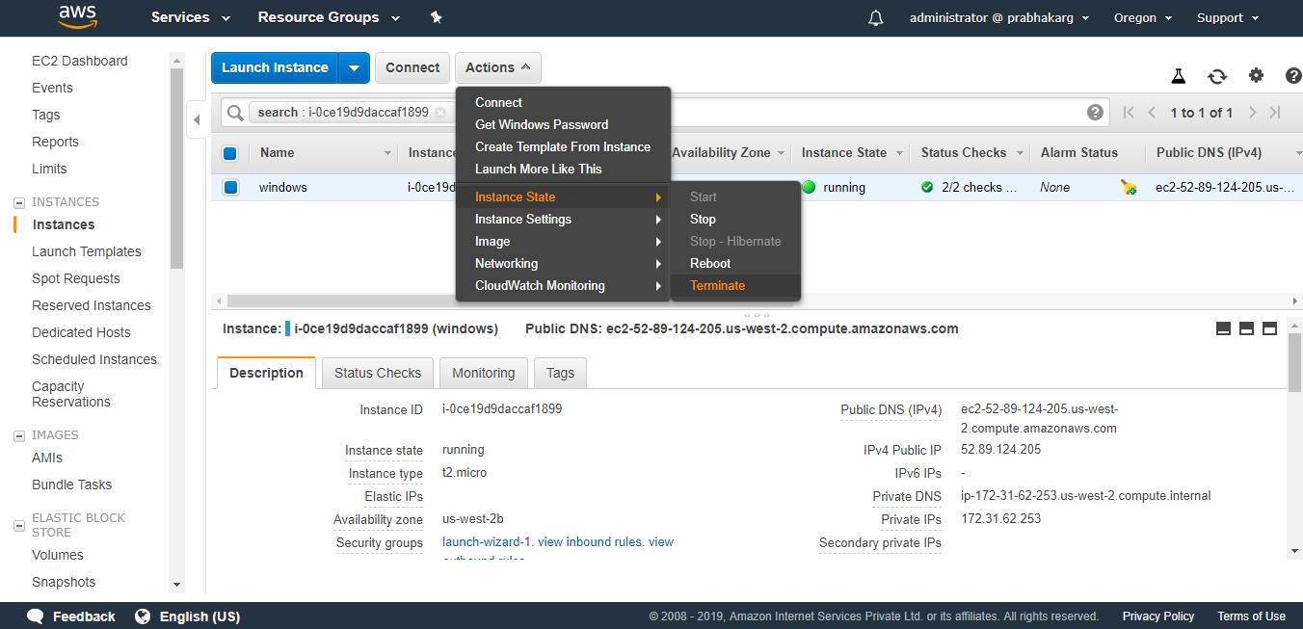
Terminating Instances

Slide 39
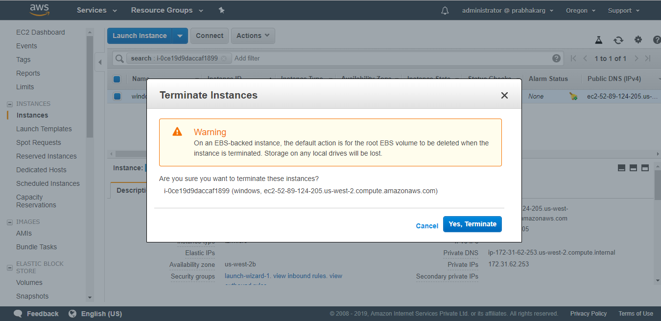
Terminating Instances

Slide 40
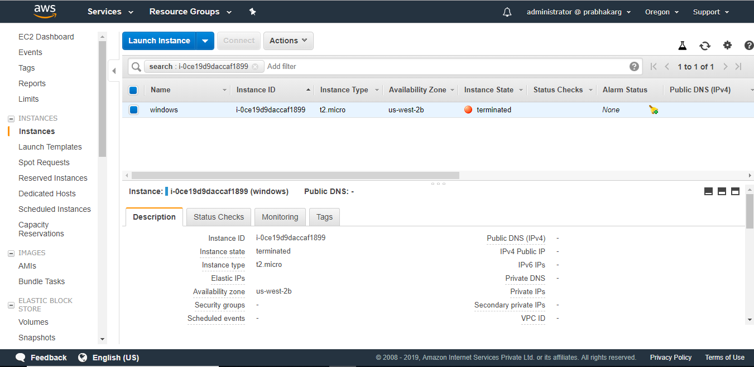
Terminating Instances

Slide 41
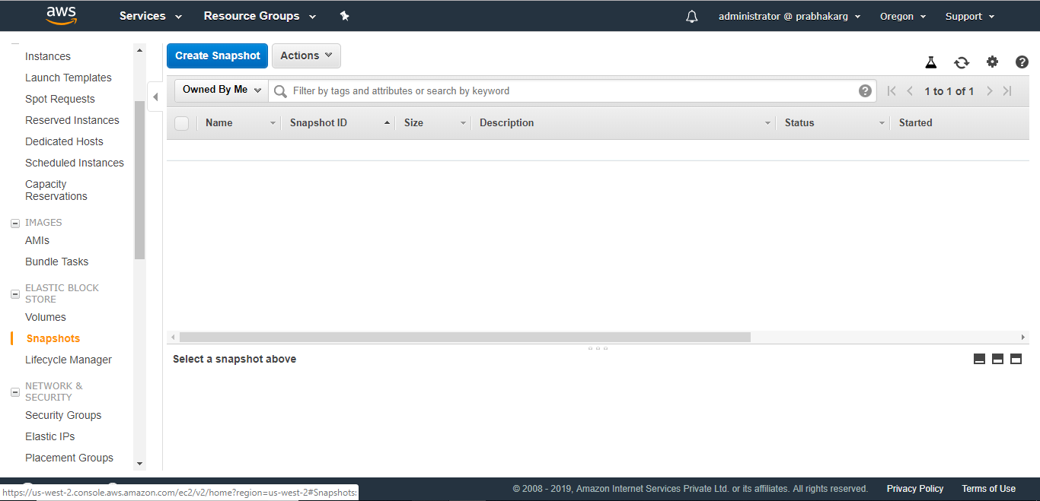
Creating a Backup of EC2 Instance (snapshots)
EBS snapshots are stored in S3 but not in a user-visible bucket.

Slide 42
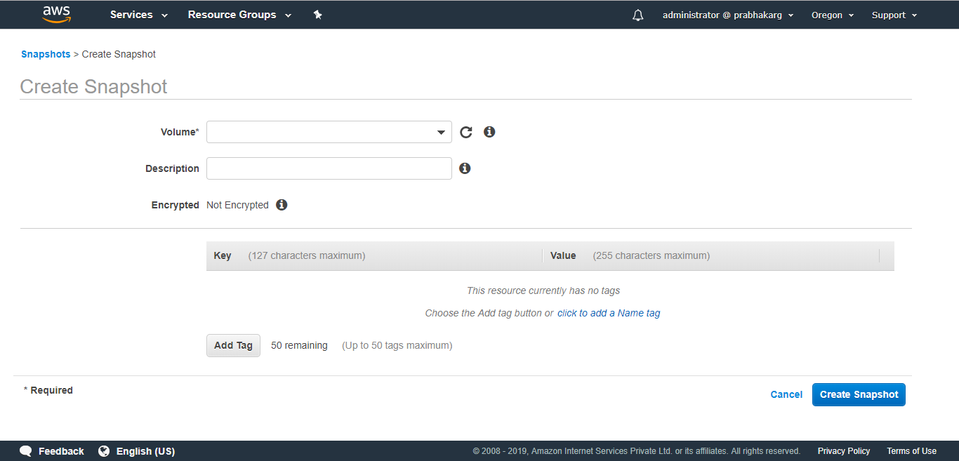
Creating a Backup of EC2 Instance (snapshots)

Slide 43
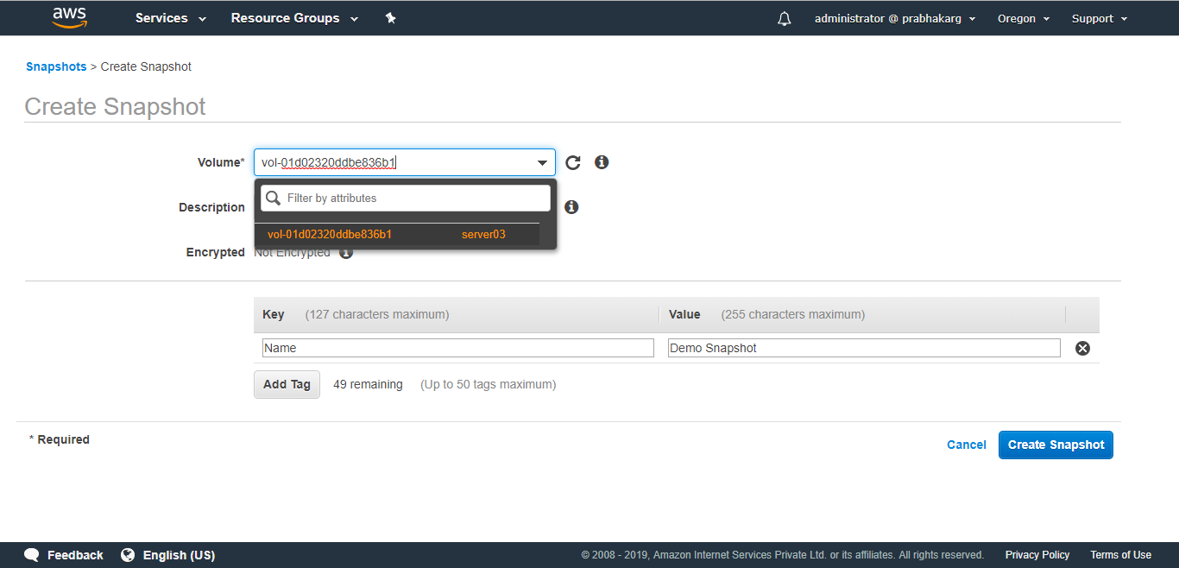
Creating a Backup of EC2 Instance (snapshots)

Slide 44
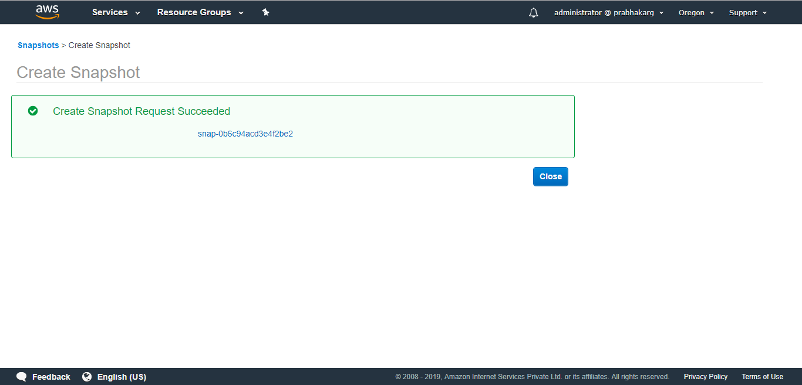
Creating a Backup of EC2 Instance (snapshots)

Slide 45
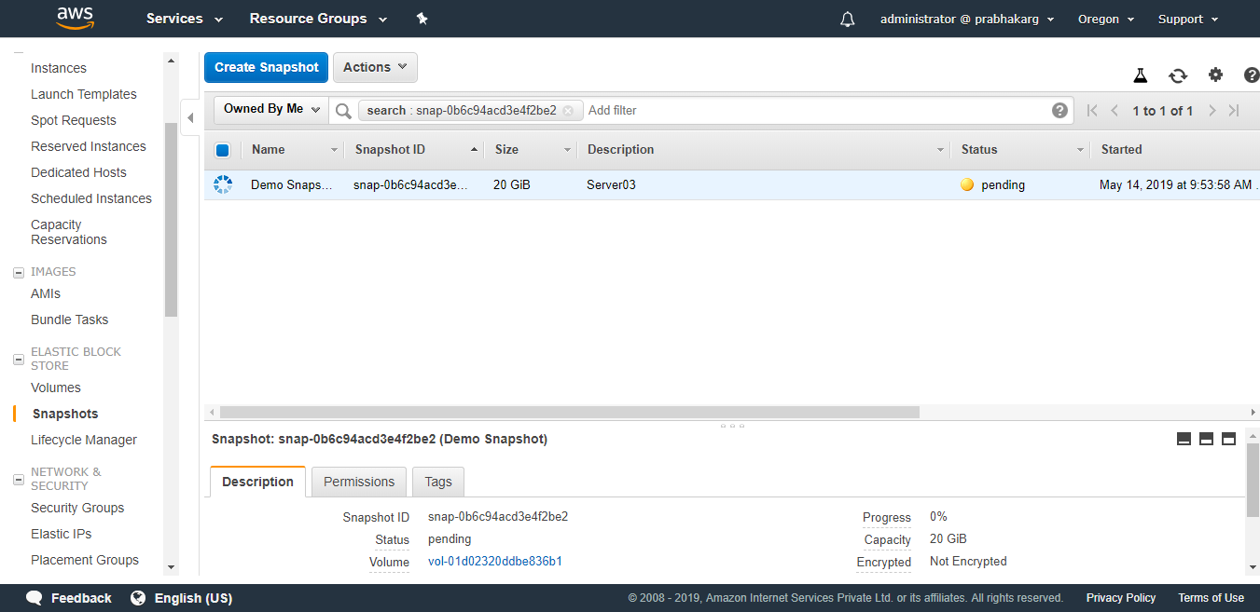
Creating a Backup of EC2 Instance (snapshots)

Slide 46
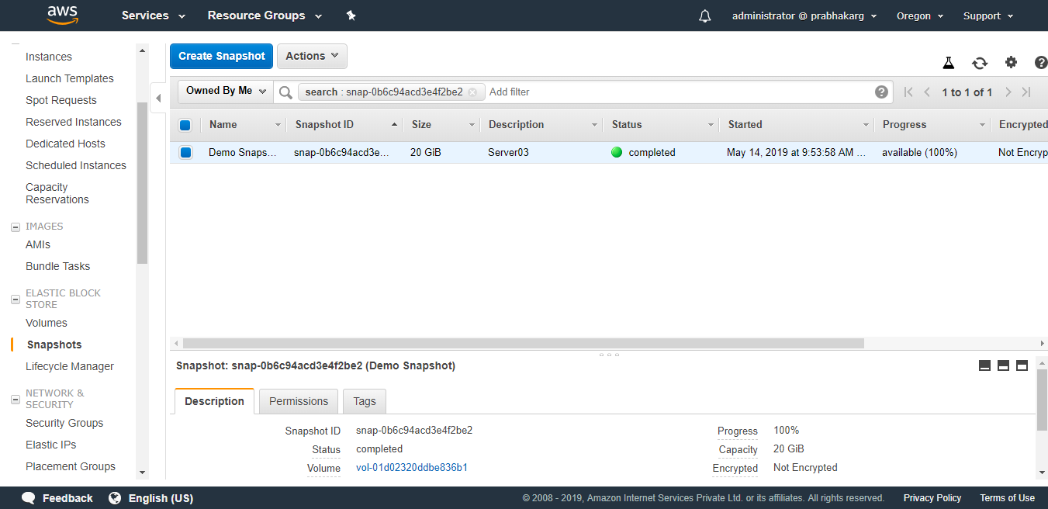
Creating a Backup of EC2 Instance (snapshots)

Slide 47
Coming Up
Elastic Compute Cloud Part III
Virtual Private Cloud AWS VPC
Thank you

